Slide 1
SQL Server Execution plans

Slide 2
Plan
Brief review of SQL Server Architecture and internals
Processing T-SQL queries processes
Execution plan theory
Demo
Operators
Query Hints
Parallelism
Optimization
Administrating
Indexes, statistics…
Files, partitions,….
Disks, networks…
Logical
rewrite query…
Architectural
Demoralization,….

Slide 3
Start
What Happens When a Query is Submitted?
Why is this query running slow?
Is SQL Server using my index?
Why isn't SQL Server using my index?
Why does this query run faster than this query?
What is execution plan?

Slide 4
SQL Server Architecture
External protocols
Database engine
Relational engine (Query Processor)
Storage engine (store\retrieve data)
SQL OS (level between OS and SQL Server)

Slide 5
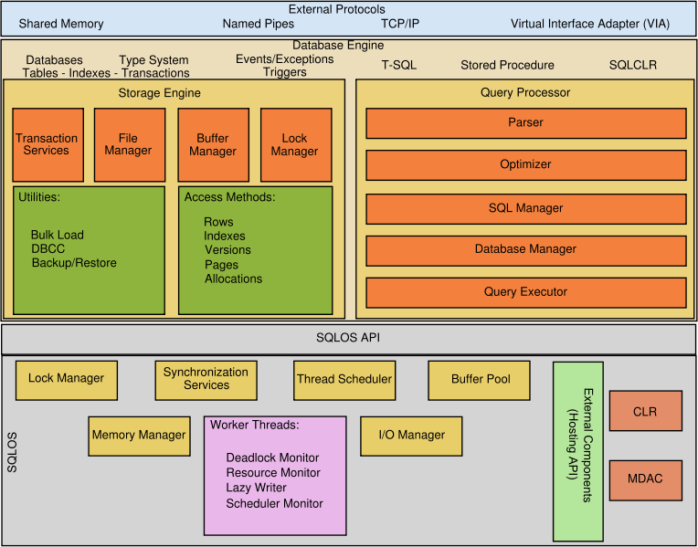
SQL Server Architecture

Slide 6
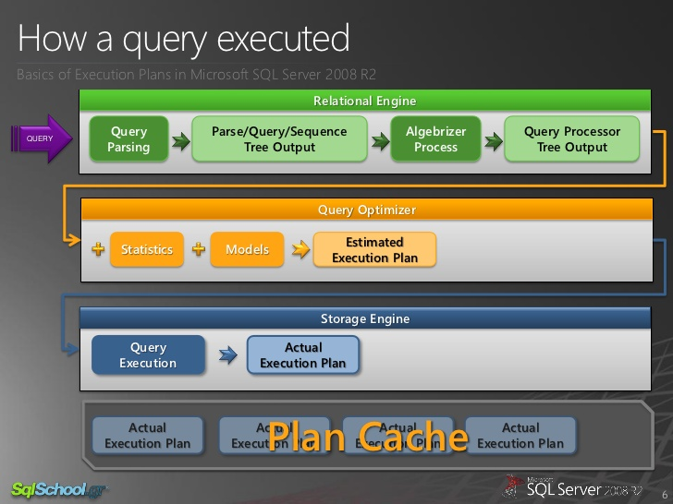
What Happens When a Query is Submitted?

Slide 7
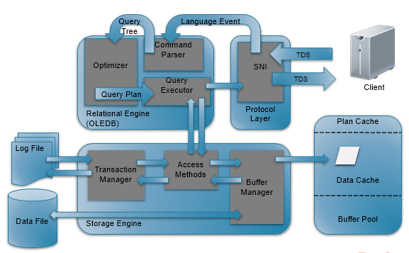
Query processing flow

Slide 8
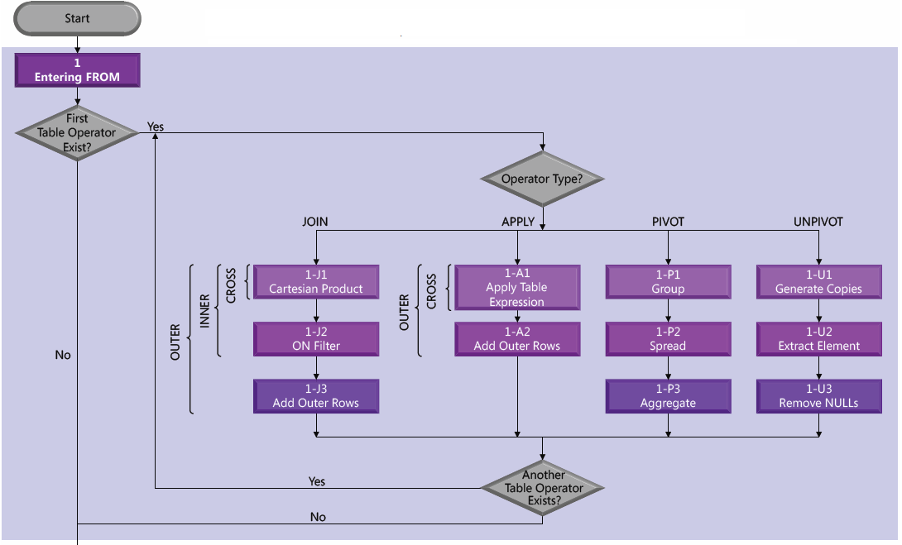
Logical query processing

Slide 9
Logical query processing

Slide 10
Logical query processing

Slide 11
Query parsing
Check the correctness of syntaxis
Exception for DDL operators (it will be not be optimized)
there is only one "right way" to create a table; there are no opportunities for improving the performance of that type of statement
Output
Parse tree (query tree)

Slide 12
Algebrizer
Resolves all the names of the various objects, tables and columns, referred to within the query (aliases, synonyms… objects exitance)
Identifies, at the individual column level, all the data types for the objects
Output:
Query processor tree (+ hash)

Slide 13
Query optimizer
Optimizer models the way in which the database relational engine works
Optimizer decisdes how best to implement T-SQL query
Statistics is the most important pieces of data for modelling
Query processor tree + statistics → execution plan
It works if there is no already a cached plan
Once the estimated plan is created → store in plan cache (Execution Plan Reuse).
The most important optimizer’s task is calculation of the execution plan cost (CPU-intensive operation → cache)

Slide 14
Execution plan cost (Query optimizer)
To make decision the optimizer calculates the cost of execution plan (required CPU, I/O)
The optimizer will generate and evaluate many plans and will choose the lowest-cost plan
it thinks will execute the query as fast as possible and use the least amount of resources (CPU and I/O).
The optimizer finds the plan with the least cost in the shortest possible number of iterations (that’s not the best possible plan).
Note: the estimated cost is just that – an estimate.

Slide 15
Statistics (Query optimizer)
Collected on columns and indexes
Describe the data distribution (represented by a histogram) and the data uniqueness (selectivity)
Statistics, by default, are created and updated automatically
Table variables (do not have statistics - optimizer assumes they contain a single row)
Temporary tables do have statistics

Slide 16
Query execution
The storage engine (executes the query physicaly)
Estmated execution plan may be changed during the actual execution process
plan exceeds the threshold for a parallel execution
the statistics used to generate the plan were out of date, or have changed since the original execution plan was created
processes or objects within the query, such as data inserts to a temporary table, result in a recompilation of the execution plan

Slide 17
Estimated and Actual Execution Plans
Look largely the same
Estimated execution plan —the output from the optimizer
The operators, or steps, within the plan are logical steps, because they're representative of the optimizer's view of the plan and don't represent what physically occurs when thequery runs
Stored in the plan cache
Actual execution plan — the output from the query executor be storage engine
It shows data representing what actually happened when the query executed
Can retrieve it only by capturing the execution of a query

Slide 18
Execution Plan Reuse
Generating execution plans is expensive operation
SQL Server will keep and reuse plans wherever possible in order to reduce that overhead (plan cache )
When we submit a query to the server, the algebrizer process creates a hash, like a coded signature of the query (query fingerprint).
If a query exists in the cache that matches the query coming into the engine, the entire cost of the optimization process is skipped and the execution plan in the plan cache is reused.
Best practice: to write queries in such a way that SQL Server can reuse their plans (stored procedures , parameterized queries, views…)

Slide 19
Cached Plan Age
SQL Server does not keep execution plans in memory forever
“cached plan age" = estimated plan cost * number of times it has been used
The lazywriter process - periodically scans the objects in the cache and decreases the “age” on -1 (each time)
plan is removed from memory if
Age = 0
more memory is required by the system

Slide 20
Recompilation of execution plan
Execution plans are not sacrosanct
Actions leads to recompilation of an execution plan
changing the structure or schema of a table referenced by the query
changing an index used by the query
dropping an index used by the query
updating the statistics used by the query
calling the function, sp_recompile
subjecting the keys in tables referenced by the query to a large number of Inserts or Deletes (which leads to statistics changes)
for tables with triggers, significant growth of the inserted or deleted tables
mixing DDL and DML within a single query, often called a deferred compile
changing the SET options within the execution of the query
changing the structure or schema of temporary tables used by the query
changes to dynamic views used by the query
changes to cursor options within the query
changes to a remote rowset, like in a distributed partitioned view
when using client-side cursors, if the FOR BROWSE options are changed.

Slide 21
Execution Plan Formats
Graphical
Text
XML

Slide 22
Graphical plans
Graphical plans are the most commonly used type of execution plan.
They are quick and easy to read.
We can view both estimated and actual execution plans in graphical format and the graphical structure makes understanding most plans very easy.
However, the detailed data for the plan is hidden behind ToolTips and Property sheets, making it somewhat more difficult to get to.

Slide 23
Text plans
These can be quite difficult to read, but detailed information is immediately available.
Their text format means that they we can copy or export them into text manipulation software such as NotePad or Word, and then run searches against them.
While the detail they provide is immediately available, there is less detail overall from the execution plan output in these types of plan, so they can be less useful than the other plan types.
There are three text plan formats:
SHOWPLAN_ALL – A reasonably complete set of data showing the estimated execution plan for the query.
SHOWPLAN_TEXT – Provides a very limited set of data for use with tools like osql.exe. It, too, only shows the estimated execution plan
STATISTICS PROFILE – Similar to SHOWPLAN_ALL except it represents the data for the actual execution plan.

Slide 24
XML plans
XML plans present a complete set of data available on a plan, all on display in the structured XML format.
The XML format is great for transmitting to other data professionals if you want help on an execution plan or need to share with co-workers.
Using XQuery, we can also query the XML data directly.
Every graphical execution plan is actually XML under the covers.
XML is very hard to read, so, useful though these types of plan are, you're more likely to use the text or graphical plans for simply browsing the execution plan.
There are two varieties of XML plan:
SHOWPLAN_XML – The plan generated by the optimizer prior to execution.
STATISTICS_XML – The XML format of the actual execution plan.

Slide 25
Managing cached plans
Managing cached plans
DBCC FREEPROCCACHE
sql_handle or plan_handle
DMO views - sys.dm_exec_query_plan
Permissions required to view execution plans
sysadmin, dbcreator or db_owner
GRANT SHOWPLAN TO [username];

Slide 26
Demo
Getting the estimated plan
Getting the actual plan
Interpreting graphical execution plans
ToolTips
Read direction
Icons, operators
Arrows
Property window
Saving XML plans as graphical plans
DMO
Automating Plan Capture Using SQL Server Trace Events

Slide 27
Language of Graphical Execution Plans
There are 78 operators
4 distinct types of operator:
Logical and Physical Operators, also called iterators, appear as blue icons and represent query execution or DML operations.
Parallelism Physical Operators are also blue icons and represent parallelism operations. In a sense, they are a subset of logical and physical operators, but entail an entirely different level of execution plan analysis.
Cursor Operators have yellow icons and represent Transact-SQL CURSOR operations.
Language Elements are green icons and represent Transact-SQL language elements, such as ASSIGN, DECLARE, IF, SELECT (RESULT), WHILE, and so on.
https://technet.microsoft.com/en-us/library/ms175913(v=sql.105).aspx

Slide 28
Topics
Operators
Joins – What's a relational system without the joins between tables?
WHERE clause – You need to filter your data and it does affect the execution plans.
Aggregates – How grouping data changes execution plans.
Execution plans for data modifications – INSERT, UPDATE and DELETE statements.

Slide 29
Operator behaviour
Most operators behave in one of two ways
Non-blocking (Merge Join…)
creates output data at the same time as it receives the input
Blocking (Hash Match, Sort…)
has to get all the data prior to producing its output. A blocking operator might contribute to concurrency problems, hurting performance.

Slide 30
Most frequently encountered operators
1. Select (Result) 2. Clustered Index Scan 3. NonClustered Index Scan 4. Clustered Index Seek 5. NonClustered Index Seek 6. Hash Match 7. Nested Loops 8. Merge Join 9. Sort 10. Key Lookup 11. Compute Scalar 12. Constant Scan | 13. Table Scan 14. RID Lookup 15. Filter 16. Lazy Spool 17. Spool 18. Eager Spool 19. Stream Aggregate 20. Distribute Streams 21. Repartition Streams 22. Gather Streams 23. Bitmap 24. Split

